Slide 1
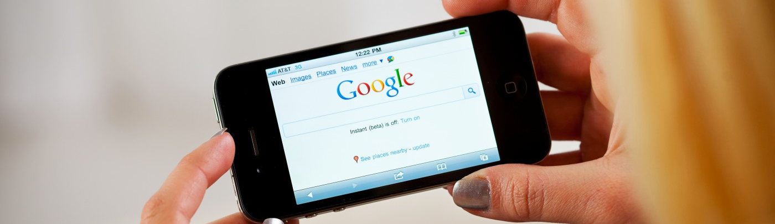

Final Project Presentation
Andrew J Parker II
Touch-Won Music App

Slide 2
MVP & Success Metrics
Touch-Won Music App
• Touch-Won music app provides as close to a full-production suite as possible on Android devices.
• Producers who are on-the-go need a way to express their music creativity as quickly and as seamlessly as possible without having to carry a full on-suite of hardware in order to create.
• Wireframes and possible mock-ups will be displayed on Kickstarter for user interaction.
• Metrics will be measured via Kickstarter Creator Dashboard linked with Google Analytics (GA). GA will be able to further break down the by entering its Tracking ID into the Creator Dashboard.

Slide 3
User Stories
Touch-Won Music App
User Epic
As a user, I want ease of functionality so creating music on the go will not take much effort.
Product Owner Epic
As a product owner, I want the UI to be simplified so the user will have the shortest learning curve possible.
As a user, I want simple workflow options so that I can customize my starting point.
As a user, I want multiple save options so that none of my current production progress is lost.
As a user, I want to be able to use sounds from various places so I can create the best music possible.

Slide 4
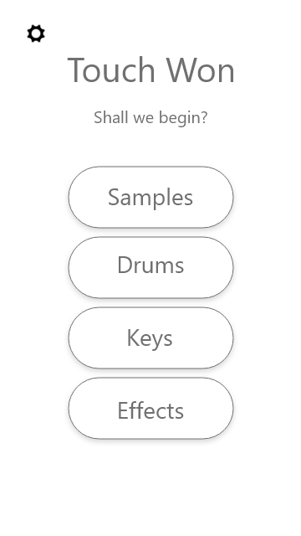
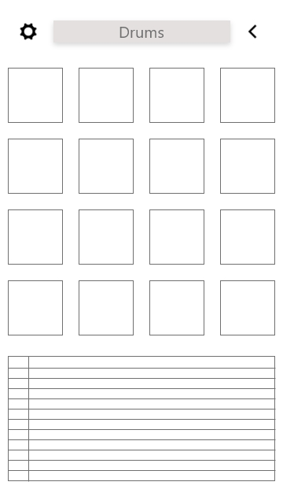
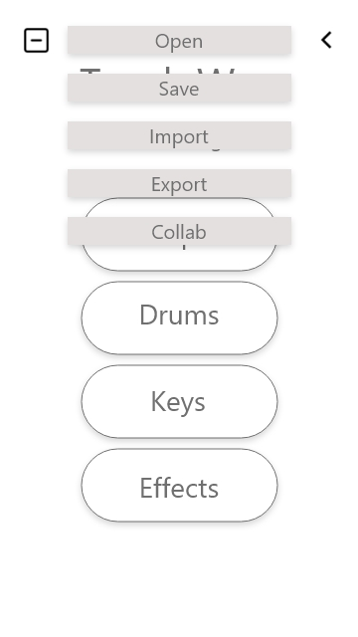
MVP Prototype
Touch-Won Music App
For small display of workflow, please click the link below
https://xd.adobe.com/view/0cfa599b-2de4-4b33-404e-bc16ee975c6b-7acb/
Home Screen
Drums Screen and Sequencer
Home Screen w/ Menu

Slide 5
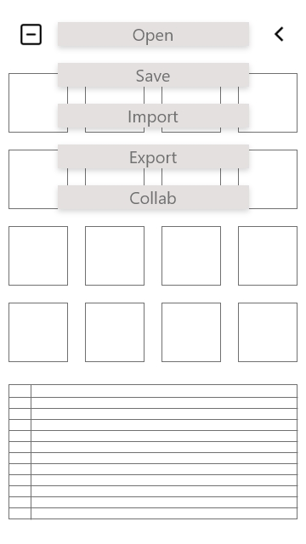
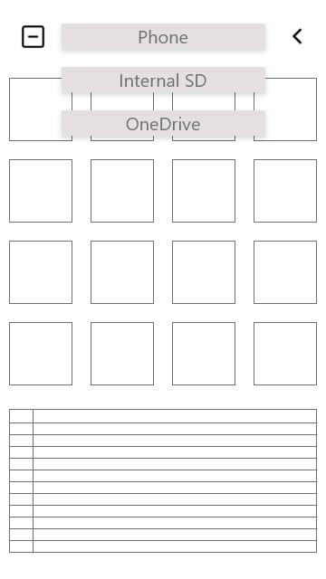
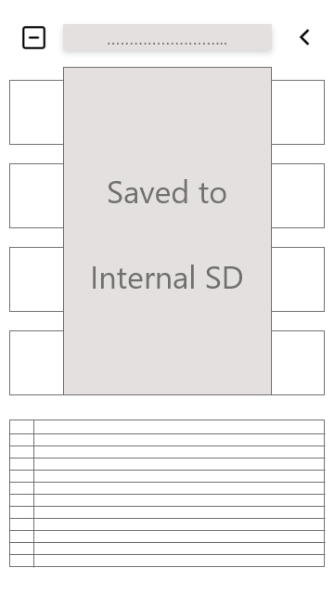
MVP Prototype
Touch-Won Music App
For small display of workflow, please click the link below
https://xd.adobe.com/view/0cfa599b-2de4-4b33-404e-bc16ee975c6b-7acb/
Drums Screen w/ Menu
Save Options
Final Save Screen

Slide 6
Go-to-Market Strategy: Positioning
Touch-Won Music App
What is it Music Production Software | Target Segment On-the-go music producers
Market Category Mobile DAW's | Competitive Alternatives FL Studio Mobile, Recording Studio, MorphWiz
Primary Differentiation Complete mobile digital audio workstation without need for plugin's | Key Benefit Access to music creativity with useable software

Slide 7
Go-to-Market Strategy: Metrics
Touch-Won Music App
Success metrics:
Clicks-per-page
Referrals: websites that referred user to campaign
Pledges
Time spent per page
Net Promotor Score (only one question)
Our success metrics will be measured via the Creator Dashboard linked with Google Analytics (GA). GA will be able to further break down the success metrics via its Tracking ID.

Slide 8
Go-to-Market Strategy: Metrics cont’d
Touch-Won Music App
Use of Kickstarter’s Creator Dashboard linked with Google Analytics will assist in answering and formulating strategies for the following questions: Acquisition — “Where Are Our Users / Customers Coming From?”
Activation — “How good is the user’s / customer’s first experience?”
Retention — “How many of your customers are you retaining and why are you losing the others?”
Referral — “How can you turn your customers into your advocates?”
Revenue — “How can you increase revenue?”

Slide 9
SWOT Analysis
Touch-Won Music App

Slide 10
Risk Matrix
Touch-Won Music app

Slide 11
Questions?

